Slide 1
Capstone Engagement
Assessment, Analysis, and Hardening of a Vulnerable System by: Bilisummaa Tucho

Slide 2
Table of Contents
This document contains the following sections:
01
Network Topology
02
Red Team: Security Assessment
03
Blue Team: Log Analysis and Attack Characterization
Hardening: Proposed Alarms and Mitigation Strategies
04

Slide 3
Network Topology
3

Slide 4
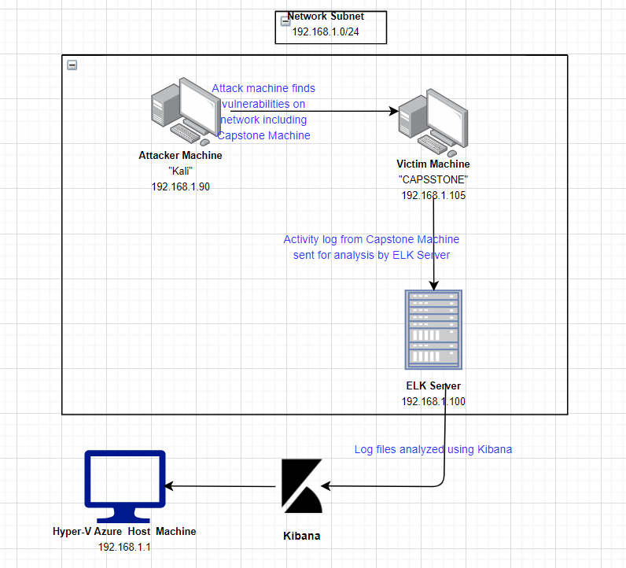
Network Topology
[Insert Here]
Use draw.io to create a diagram of the network.
Add your diagram to this slide and fill out the data in the sidebar.
Network
Address Range:
192192.168.1.0/24
Netmask:
255.255.255.0
Gateway: 192.168.1.1
Machines
IPv4: 192.168.1.1
OS: Windows 10 Pro
Hostname: Gateway
IPv4: 192.168.1.105
OS: Linux
Hostname: Capstone
IPv4: 192.168.1.90
OS: Linux
Hostname: Kali Linux
IPv4: 192.168.1.100
OS: Linux
Hostname: ELK Server

Slide 5

Red Team
Security Assessment
5

Slide 6
Recon: Describing the Target
Nmap identified the following hosts on the network:
Hostname | IP Address | Role on Network
Windows Gateway | 192.168.1.1 | Virtual Network Host – with Hyper-V
Kali Linux | 192.168.1.90 | Penetration Testing Machine – Environment containing Metasploit and tools to exploit
Capstone | 192.168.1.105 | Target Machine – The machine targeted for attack from Kali
ELK Server | 192.168.1.100 | Monitoring and Logging Machine – Log gathering utilizing Packetbeat, Filebeat, and Metricbeat

Slide 7
Vulnerability Assessment
The assessment uncovered the following critical vulnerabilities in the target:
Vulnerability | Description | Impact
CVE-2019-6579 | Port 80 open with public access | This vulnerability may provide attackers access to the system and uncover credentials, and even deliver malicious payloads.
LFI (Local File Inclusion) Vulnerability | LFI allows access into confidential files on a site. | An LFI vulnerability allows attackers to gain access to sensitive credentials
Directory Listing Vulnerability CWE-548: Exposure of Information Through Directory Listing | The directory structure is visible and accessible from a browser without any passwords. | Attackers can try many attacks from this access, and some documents with sensitive data are carelessly left available from there.
Usernames in plaintext CWE-312: Cleartext Storage of Sensitive Information CWE-256: Unprotected Storage of Credentials CWE-522: Insufficiently Protected Credentials | Usernames printed in regular text and unprotected for the public to discover in the webserver. Usernames should never be provided to the public. | Attackers can use usernames to direct bruteforce attacks directly to those names, making bruteforce attacks massively more efficient.

Slide 8
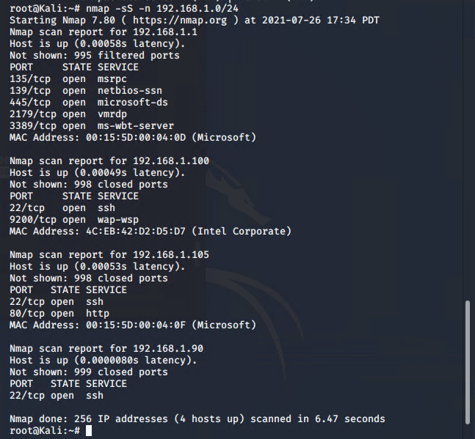
Exploitation: Open Port 80
01
02
03
Tools & Processes
Nmap
Using Nmap, open ports and services in the network was scanned.
Achievements
Via open port 80, the victim machine, Capstone, with IP address 192.168.1.105 was able to be accessed resulting in gaining access to the directory with important files..

Slide 9
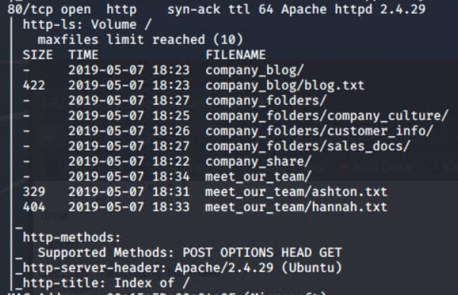
Exploitation: Directory Listing Vulnerability - CWE-548
01
02
03
Tools & Processes
Nmap
Using Nmap, the webserver directory structure was revealed.
Browser
Using a browser, simply navigating the directory structure from the IP address revealed enough information to eventually breach the system.
Achievements
Provided access to documents that yielded three usernames to be used for a bruteforce attack, as well as the location of a hidden directory, all of which will eventually yield two passwords. The secret folder will require ashton’s password, which will be the first target for bruteforcing.
Nmap

Slide 10
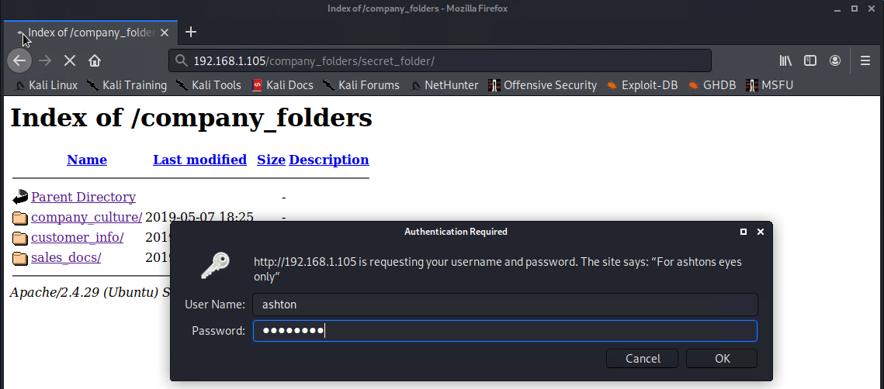
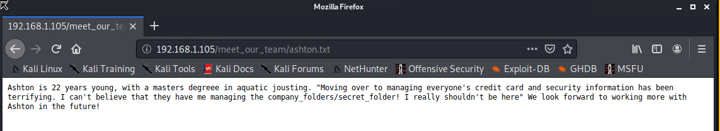
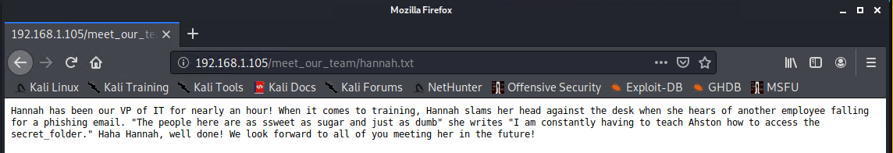
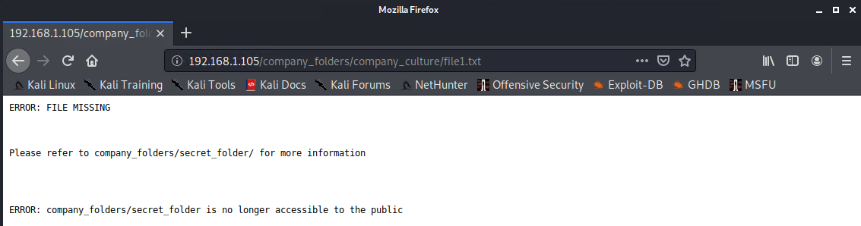
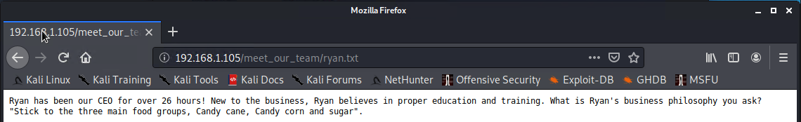
Exploring the webserver

Slide 11
Exploitation: Weak password - CWE-521
01
02
Tools & Processes
Hydra
Hydra was used to bruteforce ashton’s username against the webserver’s password protected area.
hydra -l ashton -P /usr/share/wordlists/rockyou.txt -s 80 -f -vV 192.168.1.105 http-get /company_folders/secret_folder
Achievements
This attack provided ashton’s password, which was a simple name – leopoldo.
These credentials provided:
Access to the hidden directory in the webserver. This revealed a document that contained instructions to connect to webdav with the CEO’s username and password hash.
SSH entry into system. This provided access to Ashton’s files and the first flag.txt

Slide 12
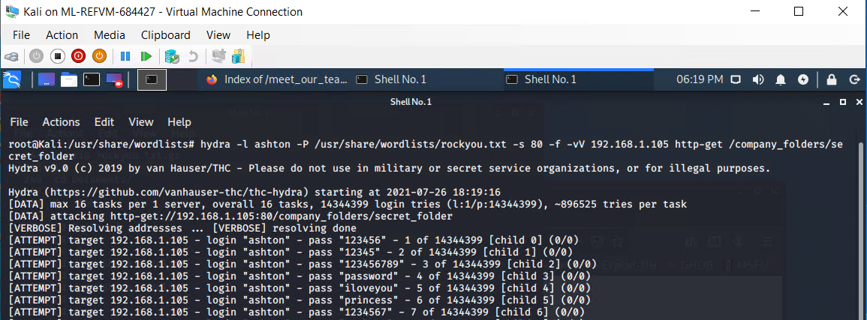
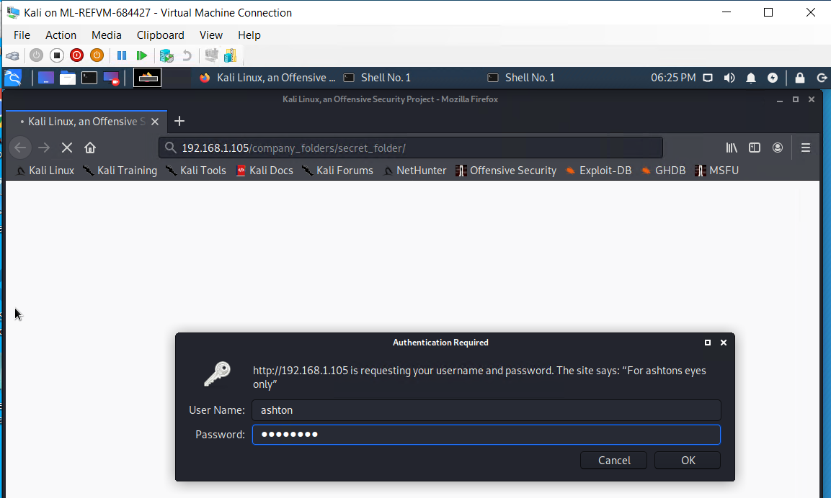
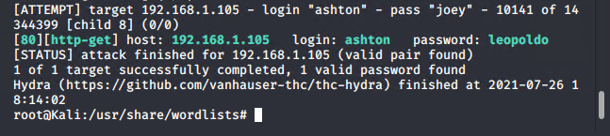
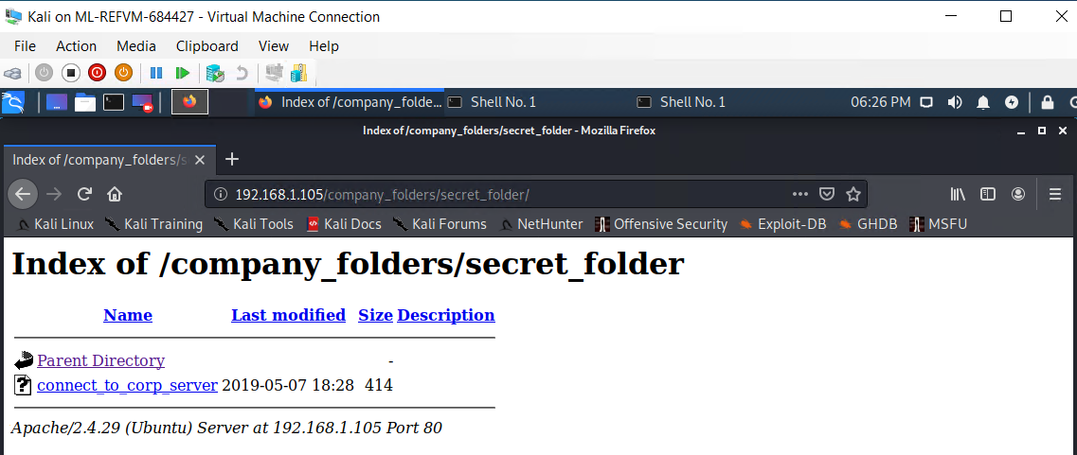
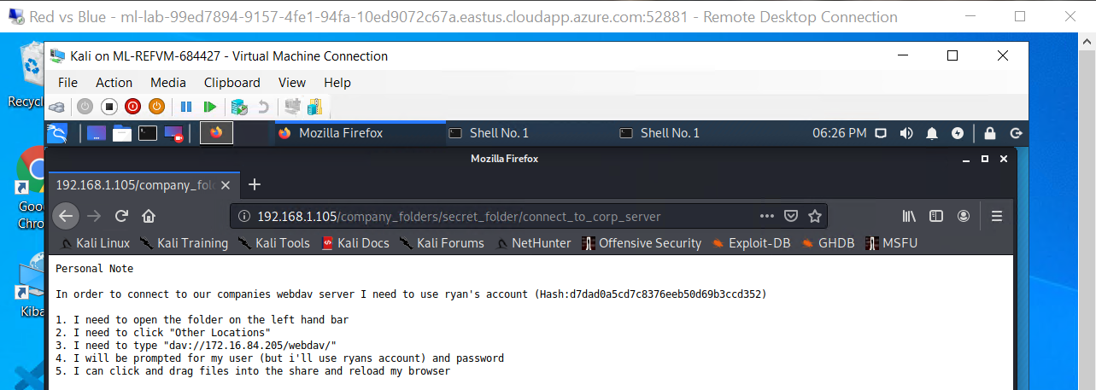
Hydra bruteforce
03
Accessing the Hidden directory

Slide 13
Exploitation: Weak hash - CWE-759, CWE-916
01
02
Tools & Processes
Crackstation
Using this online tool, the hash was simply entered into the online tool and cracked in seconds.
Achievements
This provided the password for the CEO – linux4u
This attack yielded access to webdav and the ability to upload a malicious script that would eventually provide a reverse shell.

Slide 14

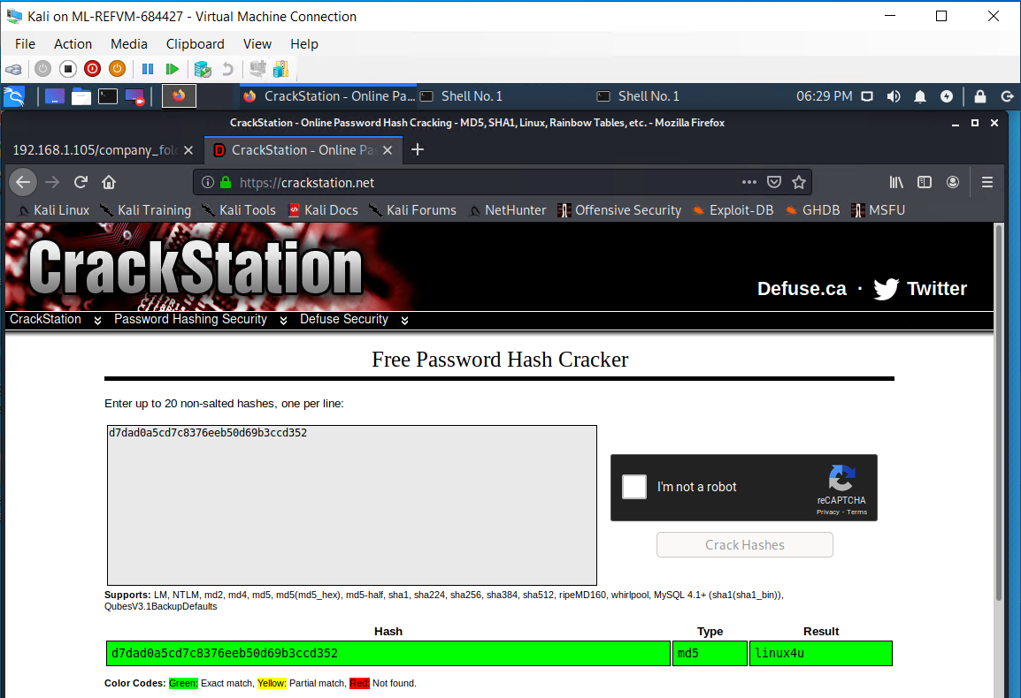
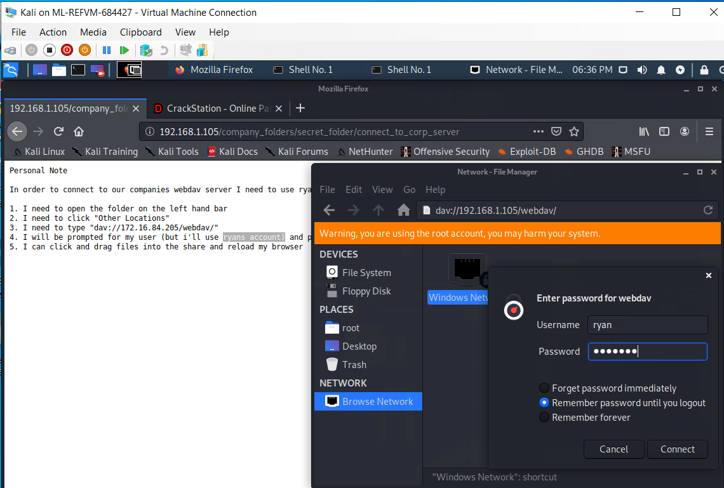
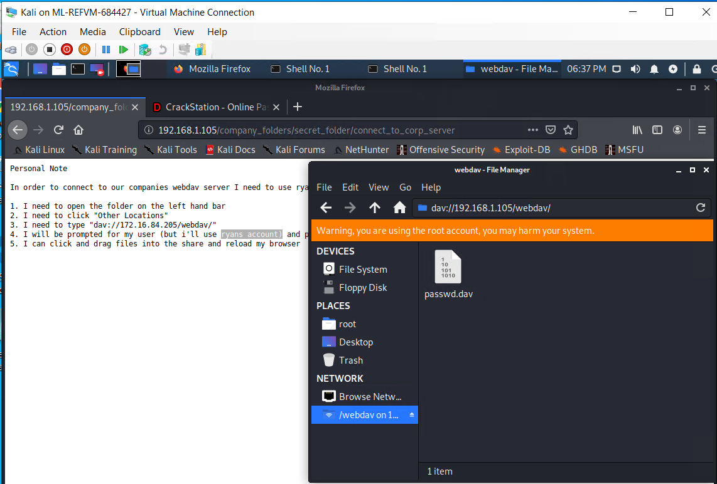
Using the online tool CrackStation
Using WebDAV accessing file with Ryan's credential

Slide 15
Exploitation: Uploading of malicioius script - CWE-434
01
02
Tools & Processes
Msfvenom – created the malicious script – shell.php
Cadaver – uploaded the payload to the webdav directory.
Metasploit – started a listener, which then launched a meterpreter session once the shell.php was run on the webserver.
Interactive shell with python -
python -c 'import pty; pty.spawn("/bin/bash")'
Achievements
Using a reverse shell, opened a meterpreter session in the target system, and achieved an interactive shell for user: www-data
Located and exfiltrated the second flag.txt

Slide 16
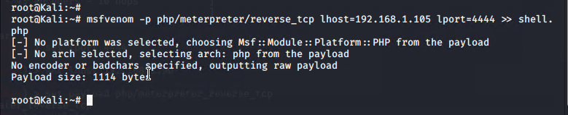
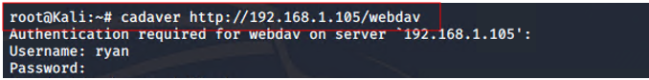
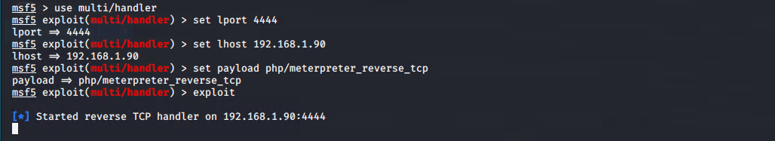
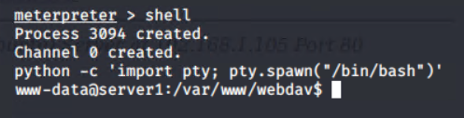
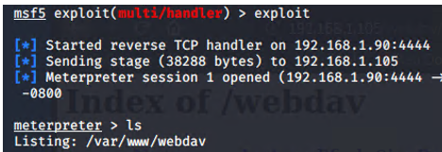
03
Creating the payload
Uploading the payload
Launching the listener
Gaining interactive shell

Slide 17
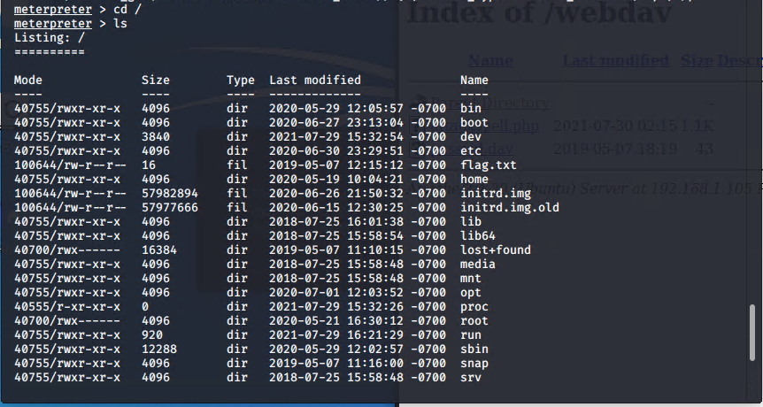
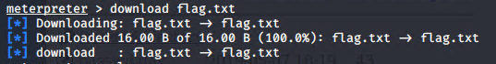
Locating and exfiltrating target document

Slide 18

Blue Team
Log Analysis and Attack Characterization
18

Slide 19


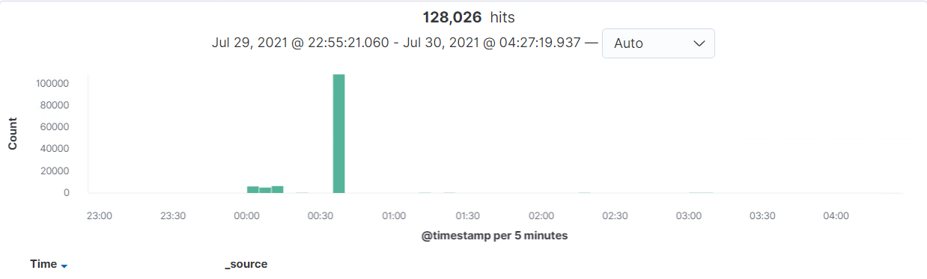
Analysis: Identifying the Port Scan
Answer the following questions in bullet points under the screenshot if space allows. Otherwise, add the answers to speaker notes.
[Insert Here]
Include a screenshot of Kibana logs depicting the port scan.
Port scan occurred on July 30th from 3:00:00 - 3:30:40
128,026 packets are sent from 192.168.1.90

Slide 20
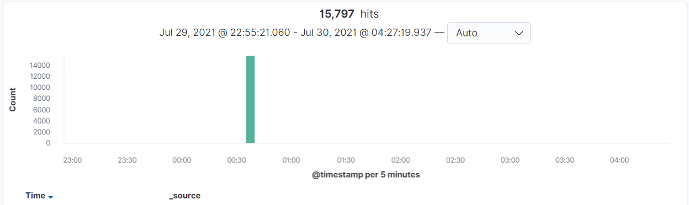
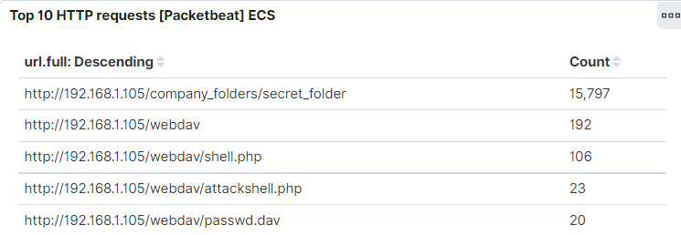
Analysis: Finding the Request for the Hidden Directory
Answer the following questions in bullet points under the screenshot if space allows. Otherwise, add the answers to speaker notes.
[Insert Here]
Include a screenshot of Kibana logs depicting the request for the hidden directory.
Request occurred on July 30th @ 00:35:00
15,797 requests were made
company_folders/secret_folder files were requested.

Slide 21
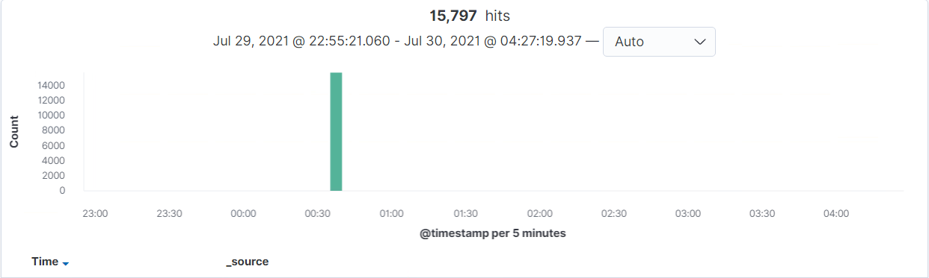
Analysis: Uncovering the Brute Force Attack
Answer the following questions in bullet points under the screenshot if space allows. Otherwise, add the answers to speaker notes.
[Insert Here]
Include a screenshot of Kibana logs depicting the brute force attack.
128,026 requests were made in the attack
15,797 requests were made before the attacker cracked the password.

Slide 22
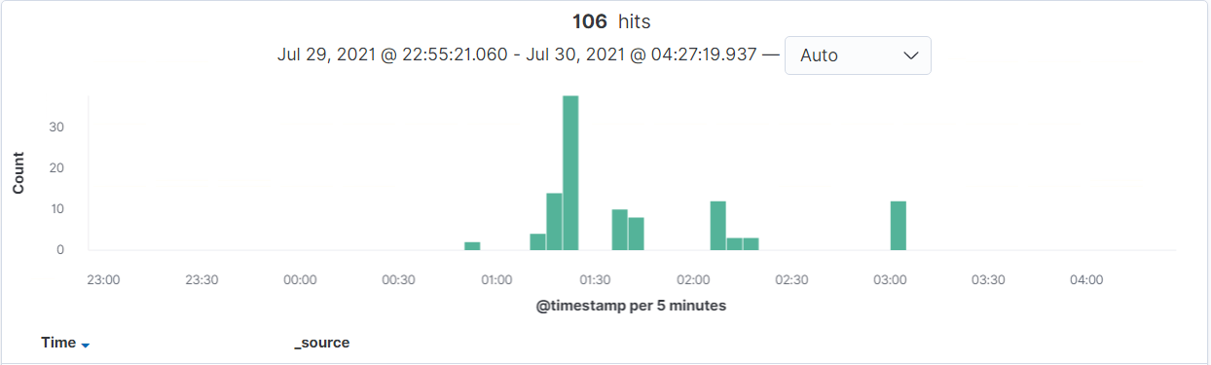
Analysis: Finding the WebDAV Connection
Answer the following questions in bullet points under the screenshot if space allows. Otherwise, add the answers to speaker notes.
[Insert Here]
Add a screenshot of Kibana logs depicting the WebDAV connection.
106 requests were made to the webdav directory
Shell.php files were requested

Slide 23
Blue Team
Proposed Alarms and Mitigation Strategies
23

Slide 24
Mitigation: Blocking the Port Scan
Though useful, having alerts for every port scan is unrealistic.
Setup a low-level alert for any port scanning, with a threshold of 10, and a severe alert for anything above 100.
Have alerts for any use of Nmap.
Setup a critical alert for aggressive scans.
Whitelist known IPs and have the firewall block unauthorised IPs from scanning.
Schedule regular security checks on all ports. Close ports that don’t need to be open. Keep all services running in ports updated.
Review IDS regularly, obfuscate and limit returned information, block the probes and host sweeps, rate-limit and slow down scans to thwart scan attempts and scan results.

Slide 25
Mitigation: Finding the Request for the Hidden Directory
Set a timeout of 30min+ for more than 3 password failures, and that time increases with every failure. Blacklist the IP after 10 failed password attempts.
Increase password strength requirements to the directory (minimum length, mixture of upper case, lower case, numbers and special characters).
Force a password reset every 3 months.
For privileged accounts create multi-factor authentication.
Limit user access to the directory.
Remove all reference to the hidden directory in the webserver.
Create 2 alerts.
1. A low-level alert for more than 3 password failures.
2. Create a critical alert for more than 10 failures.
Create an alert for non-whitelisted IPs attempting to access the directory.

Slide 26
Mitigation: Preventing Brute Force Attacks
For all password portals, such as the webserver and SSH, setup alerts for more than 3 failed attempts, and critical alerts for 10 failed attempts.
Setup account timeout and lockout rules for failed password attempts to block brute forcing. After 3 failures a 30min timer is triggered and increases with every successive password failure, up to 10, upon which the user account is locked, a password expiry is triggered and a critical alert is sent to the security team.
Increase password strength requirements and expiry every 3 months. Consider multi-factor authentication.
Rate-limit traffic to block mass password attempts.

Slide 27
Mitigation: Detecting the WebDAV Connection
Create an alert for non-whitelisted IPs connecting to WebDAV and from non-secure locations.
Limit user access to WebDAV.
Harden authentication to WebDAV – password requirements, MFA, whitelisting IPs.
Scanning all incoming traffic with anti-virus/anti-malware.
Update regularly.
Upgrade to a more secure application.
Consider only allowing internal access to WebDAV, within the companies building/network, block external connections.

Slide 28
Mitigation: Identifying Reverse Shell Uploads
Monitor all incoming uploads and setup an alert for anything triggered by anti-virus/anti-malware.
Create an alert for files that contain suspicious code/scripts/file extensions.
Setup a secure anti-virus/anti-malware application that screens all incoming files and automatically updates daily.
Update firewall rules.
Limit filetypes that can be uploaded, including restricting php.

